Slide 1
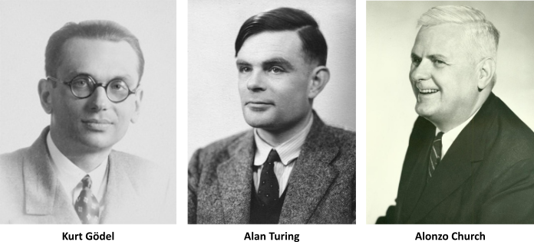
Theory of Computation Introduction
Dr G Sudha Sadasivam
Purpose:
Develop Mathematical Models of Computation that
reflect real world problems

Slide 2
Agenda
What is computability?
Models of computation? – Automata Theory
What can and cannot be computed with these models? – Computability theory
What is Time & Space efficiency? – Complexity Theory
Need to study the course
Organisation of the course

Slide 3
Introduction
Devices like PC, smart phones, robots perform computations
Computation is done using programs
Programs express algorithms
Algorithms give the process for computing input/output mapping
Tells how to convert the given input to the desired output
Every algorithm computes a function that converts input x to output f(x)
Algorithm
Abstractly:
f : D → R
Input x
Output f(x)
Computation → Programs → Algorithms → function

Slide 4
1.Complexity Theory
Consider searching and sorting algorithms, their complexity is less when compared to a scheduling problem
What makes some problems computationally easy and some computationally hard?
What problems can be solved fast?
Complexity theory classifies the problems on their degree of difficulty
Tractable Problem: a problem that is solvable by a polynomial-time algorithm. The upper bound is polynomial. Examples: Quick sort(O(nlogn)
Intractable Problem: a problem that cannot be solved by a polynomial-time algorithm. The lower bound is exponential. Examples: Travelling Salesman problem

Slide 5
2. Computability Theory
Do all functions have algorithms to implement?
For what functions can we have algorithms?
Example 1 : n- integer ; isprime(n)
Domain is set of numbers; Range : Yes or No
Example 2: Are there bugs in your program?
Define the problem/function ; But we cannot say whether there exists an exhaustive algorithm → Unsolvable
What?
How?
isprime(n) algorithm
yes if ‘n’ is prime
isprime(n) =
Input n
no if ‘n’ is not prime
Yes/no
In 1930, Godfathers – Godel, church and Turing stated that some mathematical models cannot be solved by a computer
In class of all functions only a small subset have algorithms to compute
Goal: Identify the class of functions that have algorithms to compute

Slide 6
3. Set Membership
Given a set (S) and a element ‘a’, determining whether a ɛ S is called Set membership problem. Let ‘b’ be yes/no
Function (f) and set membership graph(a,b) relationship
Graph is the set associated with function f
If there is an algorithm to compute ‘f’ then we can solve set membership of graph(f).
Algorithm exists to compute ‘f’. Hence f(a) evaluates to b . This implies for set (a,b) , f(a)=b. This implies that graph(f) exits
f : D→ R
a ɛ D and b ɛ R
Graph (f) =
{(a.b) | f(a)=b}
So set membership shows the existence of algorithms to solve functions
→ Course deals with set membership of special sets

Slide 7
4. Automata Theory
Theory of computation is the branch that deals with how efficiently problems can be solved on a Model of Computation, using an Algorithm. – 3 theories
What are the models?
Automata theory is the Study of abstract computing devices, or “machines” – defines these computational models.
Finite Automaton
Push down automaton
Turing machine
Formal Language: defines the grammars recognized by an automaton
Regular grammar
Context free Grammar
Context Sensitive grammar
Unrestricted Grammar
Do all models have same power?

Slide 8
Need to study the course
Hone problem solving skills – think, prove, argue, solve problem and express solutions
Complex real world problems can be abstracted using mathematical model to gain better understanding
Can model systems that do not exist – for example Quantum Computation, security models
Identifies what can be computed / solved in principle?
Analyze fundamental capabilities and limitations of computers
Hardware design and correctness verifiability
Relevant in practice
Text processing and compiler design
Programming language design, AI
Evolutionary computation, security

Slide 9
About the Course
Pre-requisites – data structures and discrete structures
Units
Finite Automaton
Grammars – CFG
PDA
Turing machines
Unsolvable/Undecidable problems
Complexity Theory
Text Books
John C Martin, “Introduction to Languages and the Theory of computation”, Tata Mc Graw Hill, New Delhi, 2007
Hopcroft, Rajeev & Ullman, “Introdcution to Automata Theory, languages & Computation”, Pearson, Asia, New Delhi, 2009

Slide 10
Evaluation
Class Tutorials– Maintenance and completion in class – 5 marks from Assignment Presentation
Assignments – 5 marks from Assignment presentation
Tutorial Tests – 3 marks + 2 marks intermittent 🡪 5 marks
CA test -1 : Units 1 & 2 (50 marks)
CA test – 2: Units 3 & 4 (50 marks)
CA test – 3 : Units 5 (35 marks)

Slide 11
Conclusion
What is computability?
Models of computation? – Automata Theory
What can and cannot be computed with these models? – Computability theory
What is time & Space efficiency? – Complexity Theory
Need to study the course
Organisation of the course

Slide 12
